Slide 1

Transport for London API Miniproject
Niklas Bergen
July 22, 2021

Slide 2
Outline
Tools used
Results
Challenges

Slide 3

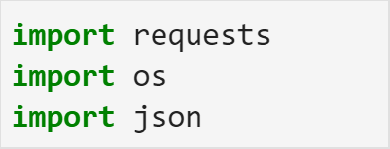
Tools Used
Jupyter Lab
Packages

Slide 4
Results

